Slide 1
Capstone Project - The Battle of Neighborhoods
Best location to open an Indian Restaurant in Manhattan, New York

Slide 2
Introduction/Business Problem
Business Problem
The City of New York is famous for its excellent cuisine. It's food culture includes an array of international cuisines influenced by the city's immigrant history.
Indian restaurants have become so popular in the United States now it seems that there is one on every corner, not only in major cities but also in smaller cities. Starting a Indian restaurant can be a great business opportunity, but you need to distinguish yourself from others to enjoy long-term success.

Slide 3
Business Problem
My client wants to open his business in Manhattan area, so I focus on that borough during my analysis.
If you plan a real restaurant that can demand higher prices for Indian Restaurants, focus on neighbourhoods and outlets that already attract a sophisticated Indian client. If you plan a cheap buffet restaurant, points to the masses looking for affordable high-traffic locations with large shopping centres and other local points of interest.
So it is evident that to survive in such competitive market it is very important to strategically plan. Various factors need to be studied in order to decide on the Location.

Slide 4

Data Selection
To identify the characteristics of our competitors' venues in Manhattan, we would first need to find out the number of Indian Restaurants in Manhattan currently and their location.
We then used Google Map API to find their geographic coordinates based on their postal code addresses.
In Manhattan, there is 1090 Indian Restaurants are currently operating.

Slide 5
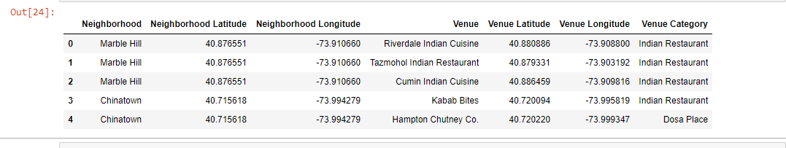
Data Selection
Next, we also used Google Map API to find their geographic coordinates of the 5 locations shortlisted for our Indian bar:
Table 2: Data frame containing geographic coordinates of our 5 shortlisted locations

Slide 6
Methodology
Addresses are converted into their equivalent latitude and longitude values.
Foursquare API is used to explore neighborhoods in Manhattan, New York.
After that, explore function to get Indian restaurant categories in each neighborhood.

Slide 7
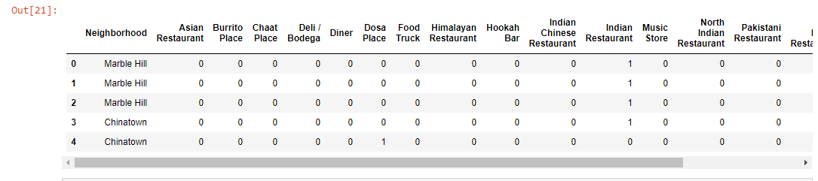
Methodology

Slide 8
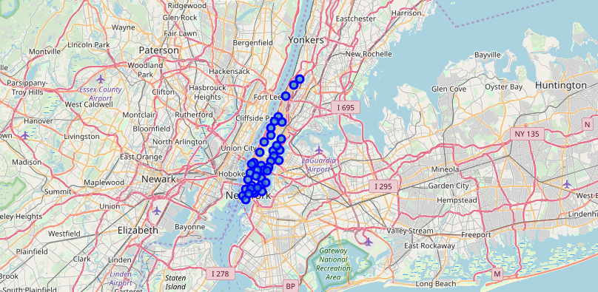
Methodology
Indian Restaurants in Manhattan

Slide 9
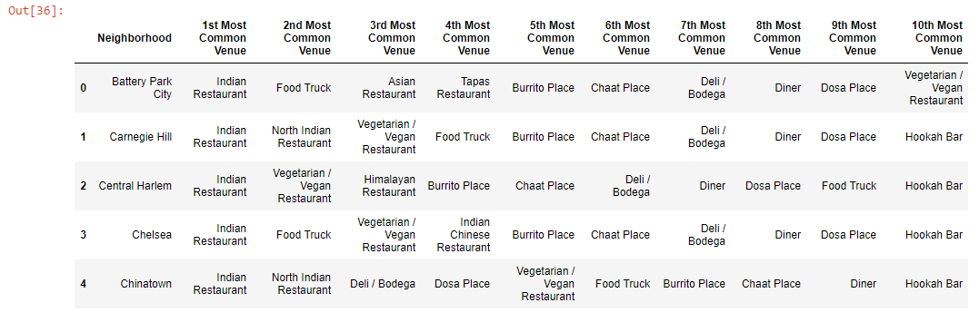
Methodology
Then using this feature to group the neighborhoods into clusters K-means clustering algorithm will be used to complete this task. And also, the Folium library to visualize the neighborhoods in Manhattan and its emerging clusters.

Slide 10
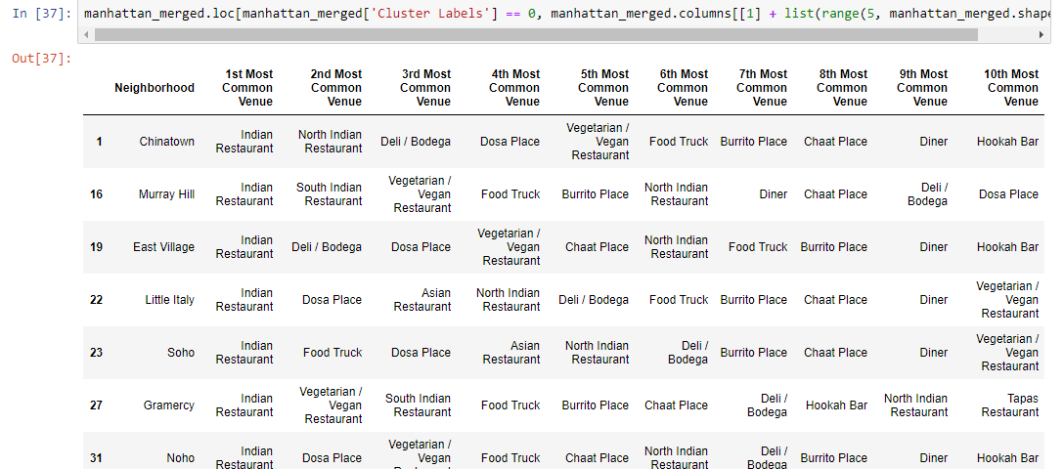
Results
Using K-mean to clustering data area with less number of sushi bars
Cluster 0

Slide 11
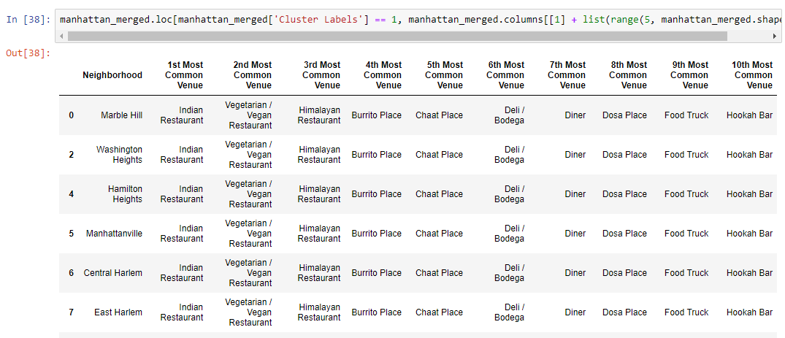
Results
Cluster 1

Slide 12
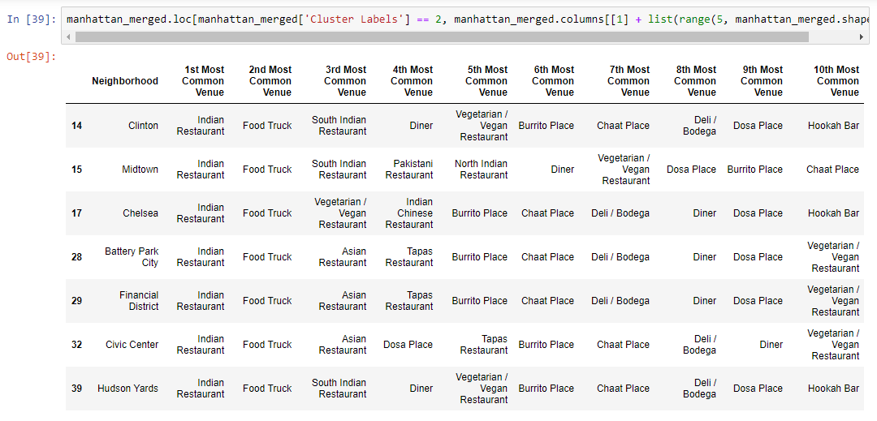
Results
Cluster 2

Slide 13
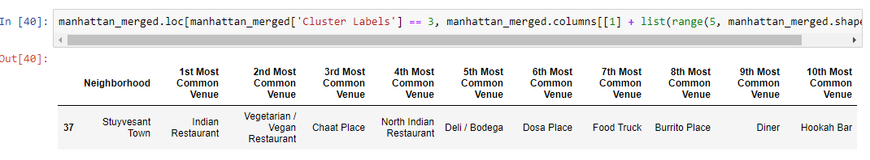
Results
Cluster 3

Slide 14
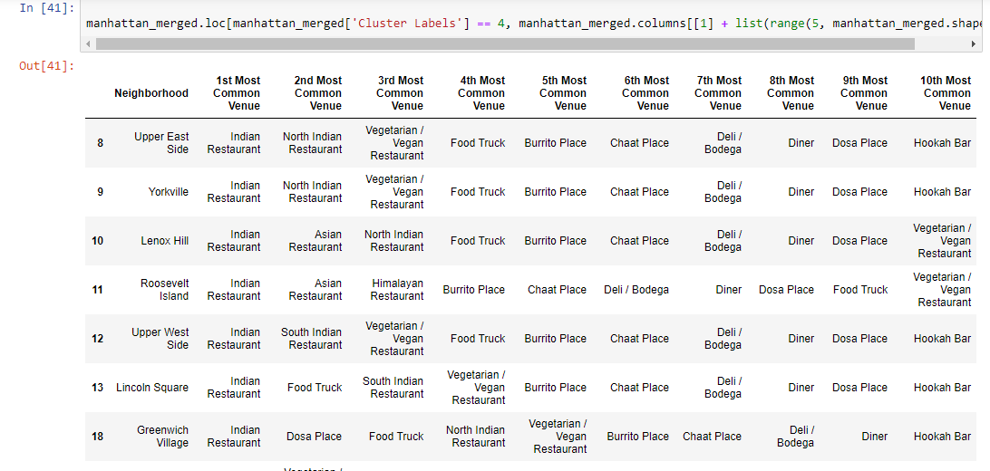
Results
Cluster 4

Slide 15
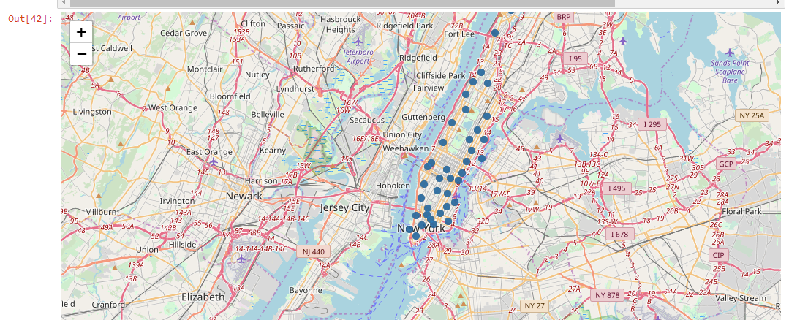
Results

Slide 16
Discussion
There is high competition in Midtown and Soho so it is very risky to open business in these areas.
Central Harlem has potential which is close to Morningside Heights area.
It can be done more detailed analysis by adding other factors such as transportation, demographics of inhabitants.

Slide 17
Conclusion
Although all of the goals of this project were met there is definitely room for further improvement and development as noted below. However, further deep analysis could be implemented to evaluate all the risks of opening a new Indian restaurant. As it could be seen from the report, Central Harlem has a potential to launch the restaurant

